Slide 1
RESTFULL API FOOD RECIPE
Muhamad Hakam Faza

Slide 2
Node.js ?

Slide 3
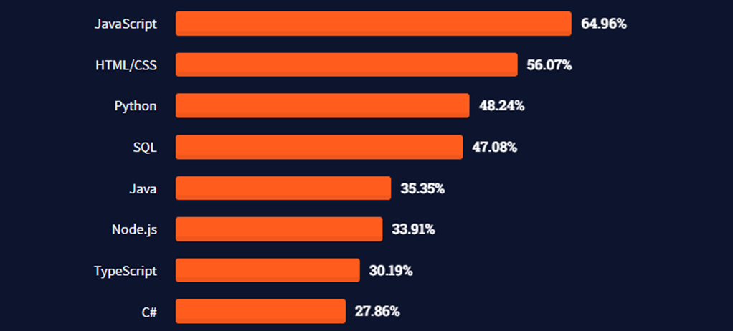
Survey Stack Overflow
https://insights.stackoverflow.com/survey

Slide 4
Express ?

Slide 5
Google V8 Engine
Community
JavaScript

Slide 6
PostgreSQL ?

Slide 7
Function
Data Type
Deficiency and Advantages

Slide 8
REST API ?

Slide 9
URL Design
HTTP Verbs
HTTP Response Code
Format Response

Slide 10
GET
WAYS OF WORKING
POST
PUT
DELETE

Slide 11
User
Recipe
Comment

Slide 12
SHOWCASE PROJECT

Slide 13
Any Question?

Slide 14
Trima Kasih

